Slide 1
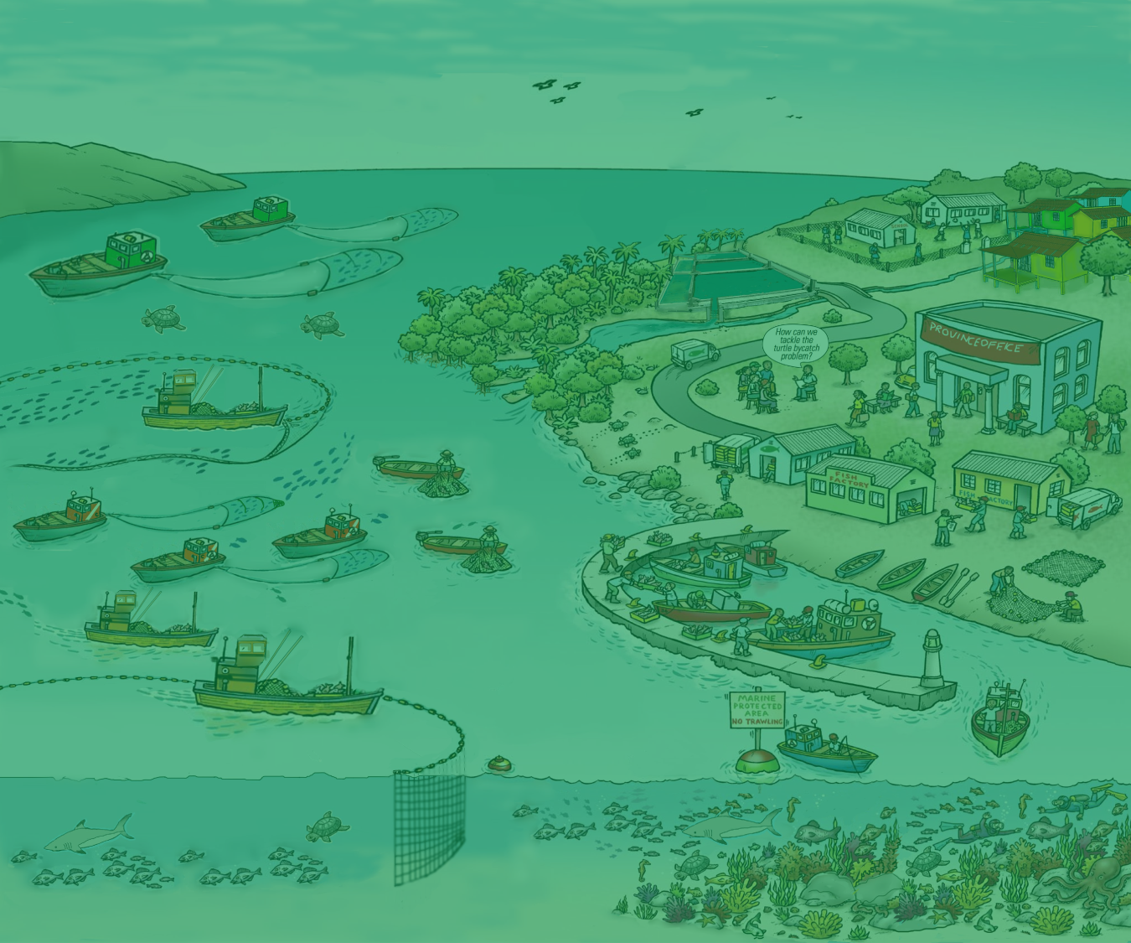
7. EAFM process overview
Version 1

Slide 2
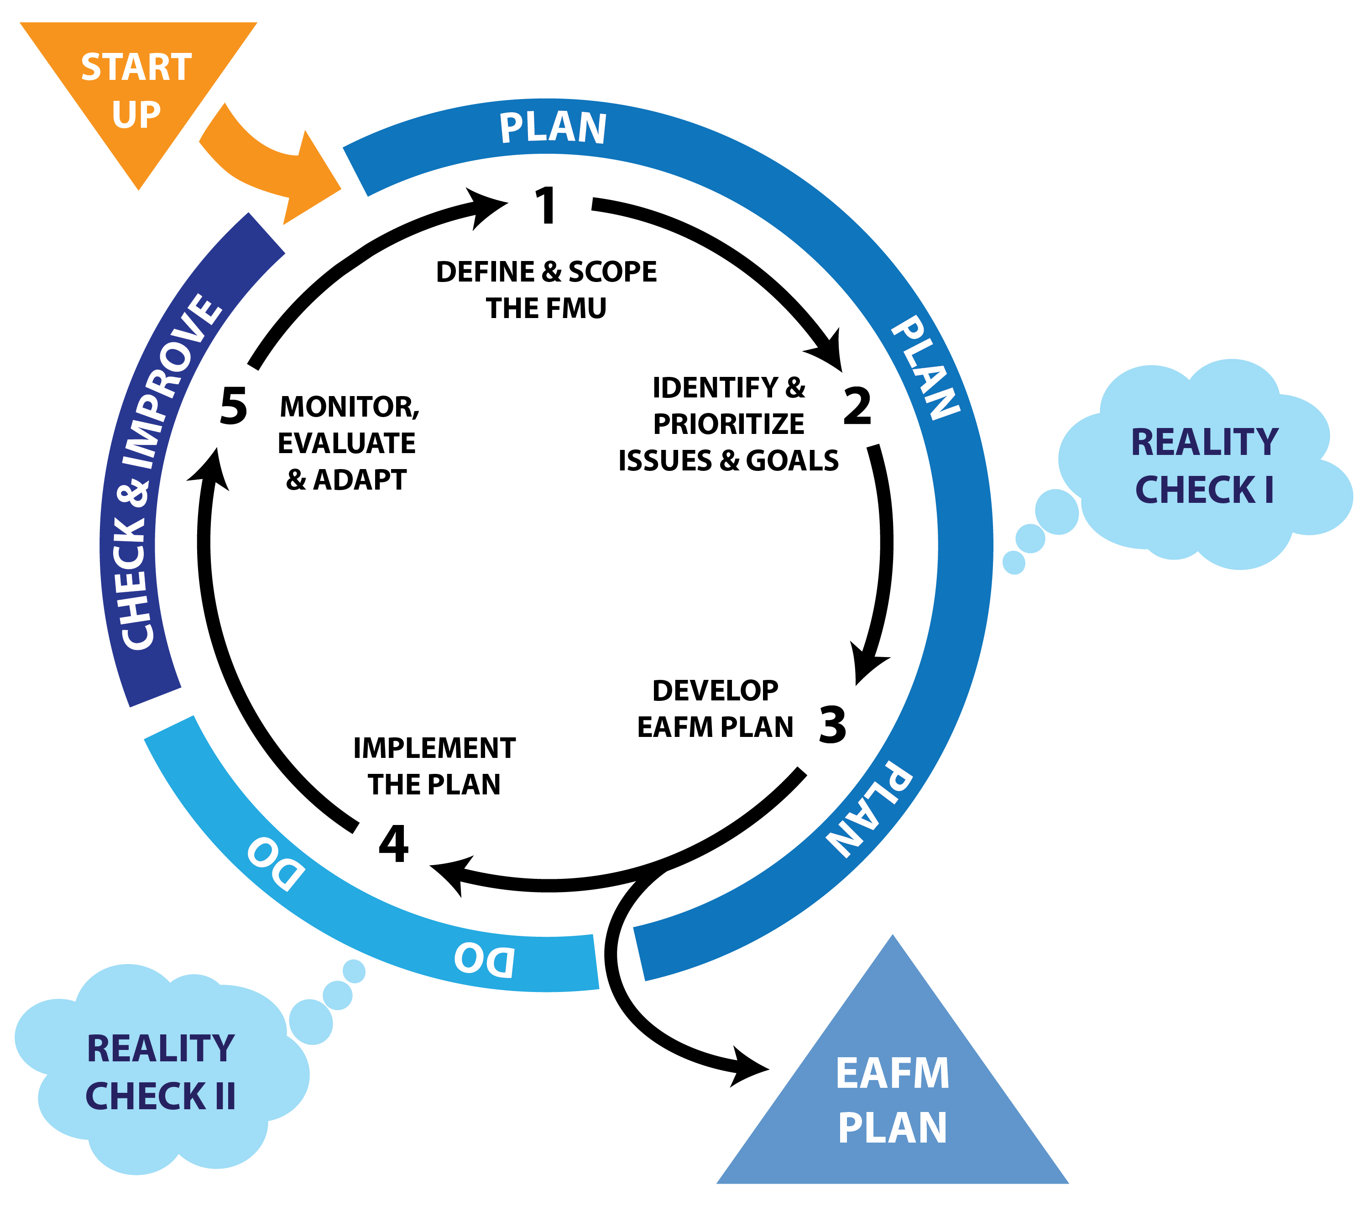
The 5 steps of EAFM
2
Notes:
This is first time the cycle visual is introduced in the course; it will be a recurring visual.
STRESS that this module gives a quick run through what we will cover over the week. Its like a snapshot without detail and needs to be run through quickly. Point to each element as you talk. Terms like FMU will be defined shortly.
[Some participants like to see the structure of the course, while others will be happy to skip this]
Refer to picture of this on wall-visual gallery (keep up as reference throughout course to remind participants of the steps through the cycle, so we can see every day how we are moving along).
There are 5 EAFM steps that fit under the general management cycle (outer circle).
Moving anti-clockwise around the cycle…….
The 5th step aligns with checking and improving
And the 4th step aligns with doing.
The planning phase into 3 steps; the output of these is an EAFM plan.
Before you start the process, you need to get organised and engage stakeholders – this is called STARTUP.
There are also 2 reality checks to make sure that we are being realistic and achievable.

Slide 3
Startup A
Prepare the ground
Identify who should be involved
What is planned to happen (plan for the process)
Decide on the general location
3
Notes:
STARTUP A is getting organized and preparing the ground.
Many of the tasks in STARTUP A are only done once at the beginning of the process.

Slide 4
Startup B
Stakeholder engagement
Engage stakeholders for:
Participatory planning
Co-management
4
Notes:
In STARTUP B we engage the stakeholders.
The tasks in B are ONGOING: they are started here and continue throughout the lifetime of EAFM process.

Slide 5
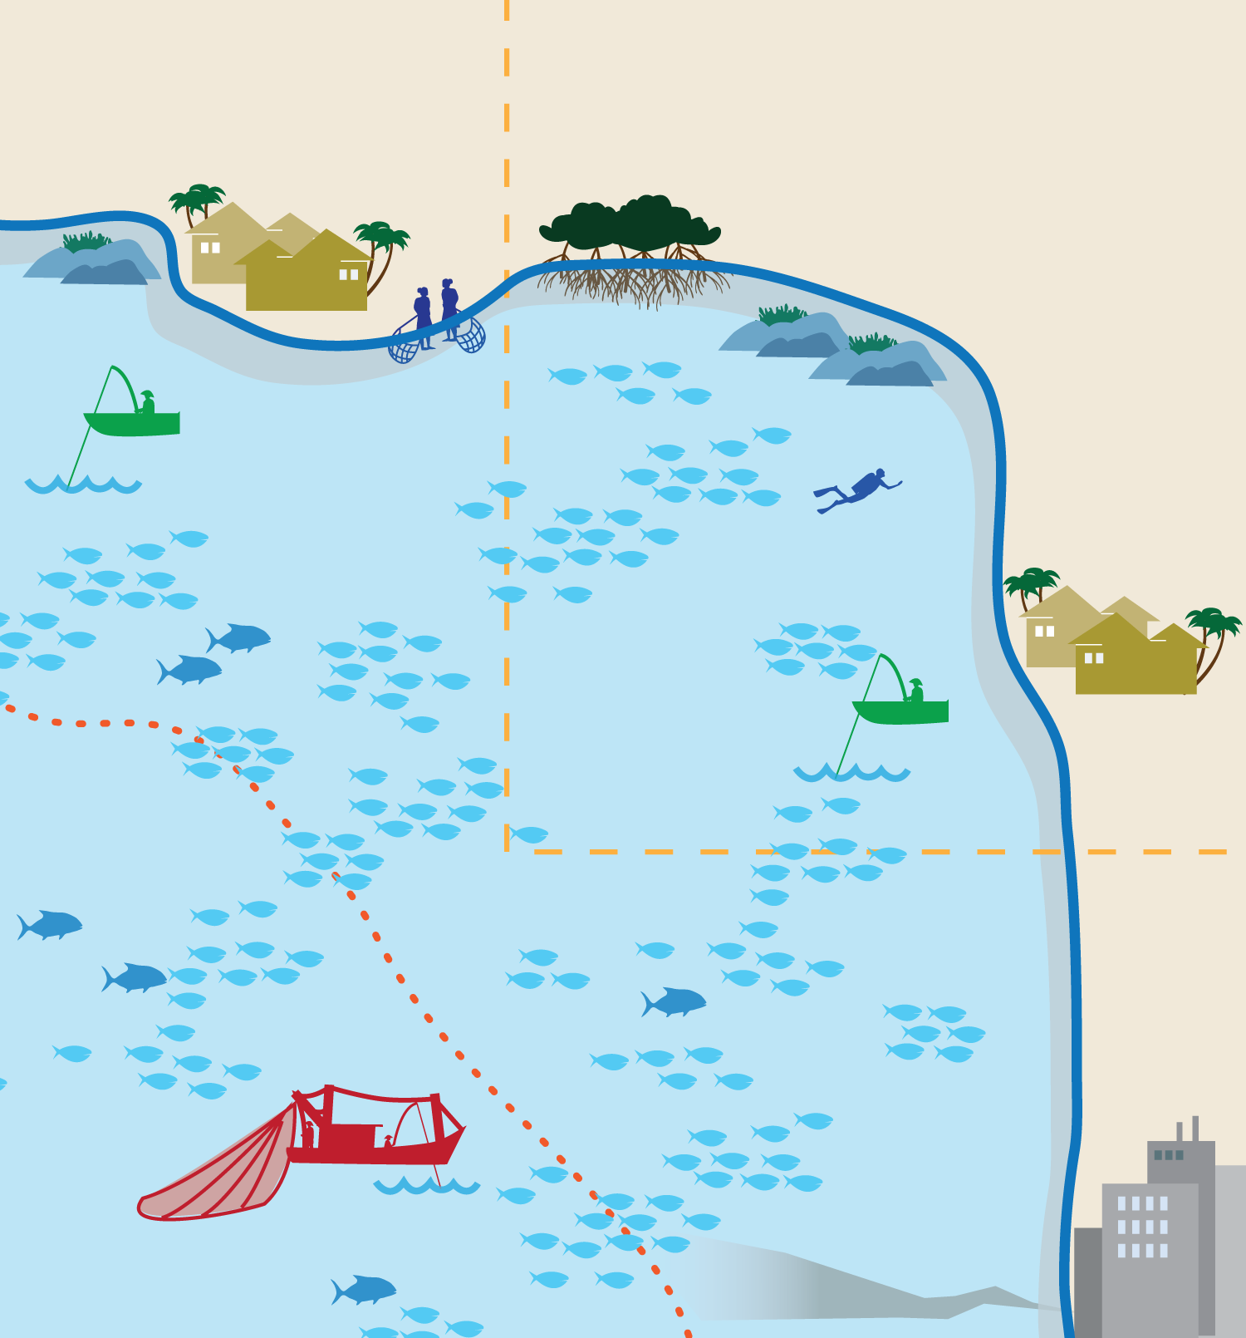
Step 1
Define and scope the Fisheries Management Unit (FMU)
1.1 Define the FMU
1.2 Agree the FMU vision
1.3 Scope the FMU
Provides background information and a vision
5
Notes:
Step 1 is called “Define and scope the Fisheries Management Unit”. In this step, stakeholders agree on a vision and pull together relevant background material.

Slide 6
Step 2
Identify & prioritize issues & goals
2.1 Identify threats & issues
2.2 Prioritize issues
2.3 Define goals for EAFM plan
Identifies the high priority issues and sets goals
6
Notes:
In Step 2, we firstly identify all the issues that affect the fishery and then we prioritise them. This allows us to set a number of goals about what we want to achieve in the longer term.

Slide 7
Reality check I
Reality check l
-Constraints & opportunities
-Facilitation / skills
-Conflict management
Are the goals achievable?
7
Notes:
At this point we carry out a reality check to look at constraints and opportunities.

Slide 8
Step 3 Developing the EAFM plan
3.1 Develop operational objectives
3.2 Develop indicators & benchmarks
3.3 Management actions & compliance
3.4 Identify sustainable financing
3.5 Finalize the EAFM plan
Develops the management framework
8
Notes:
In Step 3, the plan is developed based on the previous inputs from steps 1 & 2.

Slide 9
Step 4 Implement
4.1 Formalize, communicate and engage
Implements the plan through formalizing and communicating it
9
Notes:
The plan needs to be formalized and communicated, or else it will be just another plan on some one’s desk. This is carried out in step 4 along with some considerations of how to implement it.

Slide 10
Reality check II
Checks whether the governance and supporting structures are in place
Reality check II
-Governance
-Co-management
-Supportive environment
10
Notes:
In Reality Check II we check to see whether the governance and supporting structures are in place.

Slide 11
Step 5
Monitor, evaluate, adapt
5.1 Monitor & evaluate (M&E) performance of management actions
5.2 Adapt the plan based on M&E
Completes the EAFM cycle with M&E and adapts the plan to start a new cycle
11
Notes:
Step 5 is a critical, often forgotten stage. It is necessary to show you are on track, to help adapt the management properly, as well as to show results.
It needs to be planned, otherwise it will not happen.

Slide 12
EAFM cycle
Planning – Steps 1-3
1. Define & scope
2. Issues & goals
3. Objectives, indicators, management actions & compliance, financing
Doing - Step 4
4. Implement
Checking & improving - Step 5
5. Monitor, evaluate and adapt
12
Notes:
In summary – the EAFM cycle has 5 steps, 3 are planning, one is doing and one is checking and improving.
Refer back to session 6 just before this one where we agreed that we need PLANS to link (existing) policies to action (i.e. to be able to actually implement those policies).

Slide 13
EAFM Plan outline
EAFM Management Plan for FMU XX
Vision (Step 1)
Background (Step 1)
Major threats and issues (Step 2)
Goals (Step 2)
Objectives, indicators and benchmarks (Step 3)
Management actions (Step 3)
Compliance (Step 3)
Data and info needs – source of data, etc (Step 3)
Financing (Step 3)
Communication – link to communication strategy (Step 4)
Review of the plan – link to frequency of reviews (Step 5)
13
Notes:
These steps are represented by the headings in a typical EAFM Plan.
Tell the participants that they will be developing one of these during the course. EAFM plan as an output and guiding tool. Refer to same template on visuals gallery on wall.

Slide 14
Key messages
The EAFM process cycle has 5 steps
Before the first step in the cycle, get organized in the Start-up
The EAFM plan comes from the outputs of Steps 1-3
In Step 4 the plan is implemented
In Step 5 the plan is evaluated and adapted for the next cycle
14
Notes:
Self explanatory

